Slide 1
CS 5402 Introduction to Data Mining
Data Mining Methods - PRISM and Association Rules
v.1
Perry B. Koob, koobp@mst.edu

Slide 2
What we are going to learn.
Covering Algorithms
PRISM
Association Rules

Slide 3
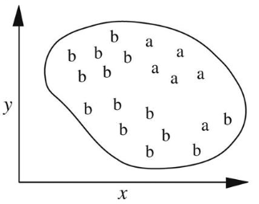
Covering Algorithms
Covering Algorithms divide the dataspace into distinct regions that contain the data points that are in the class we are interested in.
We divide the dataspace using IF...THEN rules.

Slide 4
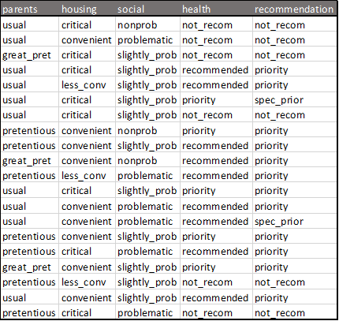
PRISM
We start with our original data.
Then we get count for each (Attribute, Value) pairs as conditions, by Class.

Slide 5
PRISM
We start with our original data.
Then we get count for each (Attribute, Value) pairs as conditions, by Class.
Example: parents = usual

Slide 6
PRISM
We start with our original data.
Then we get count for each (Attribute, Value) pairs as conditions, by Class.
Example: parents = usual
We see this condition:
3 times when the Class is not_recom
5 times when the Class is priority
2 times when the Class is spec_prior

Slide 7
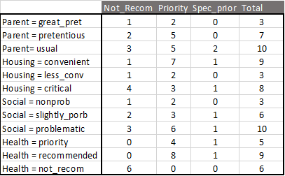
PRISM
We build up frequency counts like this…
The counts are the Coverage of the condition.

Slide 8
PRISM
Let’s build a covering Rule for people who would get a priority recommendation.
recommendation = priority

Slide 9
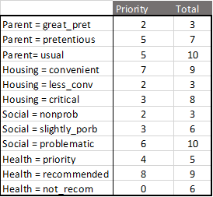
PRISM
Let’s build a covering Rule for people who would get a priority recommendation.
recommendation = priority

Slide 10
PRISM
Let’s build a covering Rule for people who would get a Priority Recommendation.
Recommendation = Priority
… or as stated as a rule
If ? then Recommendation = Priority
Let’s build a covering Rule for people who would get a priority recommendation.
recommendation = priority
… or as stated as a rule
If ?
then recommendation = priority

Slide 11
PRISM
Let’s build a covering Rule for people who would get a Priority Recommendation.
Recommendation = Priority
… or as stated as a rule
If ? then Recommendation = Priority
Let’s build a covering Rule for people who would get a priority recommendation.
recommendation = priority
… or as stated as a rule
If ?
then recommendation = priority
Left Hand Side (LHS)
Right Hand Side (RHS)

Slide 12
PRISM
LHS ∩ RHS
or
Coverage
Let’s build a covering Rule for people who would get a Priority Recommendation.
Recommendation = Priority
… or as stated as a rule
If ? then Recommendation = Priority
Right Hand Side (RHS)

Slide 13
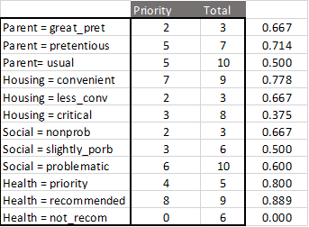
PRISM
We look at the ratio between the number the number of times the condition appears with the Class we want and the total number of time the condition appears.

Slide 14
PRISM
We pick the one with the largest ratio, heath = recommended, and add that to our Rule.
If heath = recommended and
?
then recommendation = priority

Slide 15
PRISM
Data Space without Rules
If heath = recommended and
?
then recommendation = priority
This is a partitioning of the data.
Everything that matches this condition will be in one part of the dataspace.
Everything else is in the other.
health = recommended

Slide 16
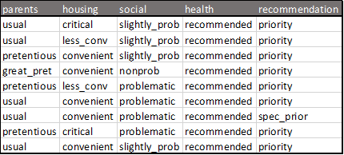
PRISM
If heath = recommended and
?
then recommendation = priority
We look at our dataspace our rule has specified.
We get the frequencies for other attributes with the data in our dataspace.

Slide 17
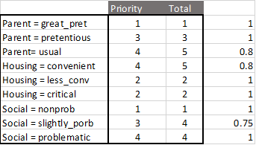
PRISM
We look at the conditions to see if we can do better by adding more.
If we wanted 100% we could go with...
If heath = recommended and
social = problematic
then recommendation = priority

Slide 18
PRISM - Accuracy
The Rule we generated...
If heath = recommended and
Social = problematic
then recommendation = priority
.. will pick 4 of the 12 examples where recommendation = priority.
4/12 is the accuracy of our Rule.
Accuracy = LHS ∩ RHS / RHS = Coverage / RHS

Slide 19
PRISM
We remove the 4 examples from the data set that we were able to classify with our Rule and then generate more Rules where recommendation = priority to try and get better accuracy.
Ultimately we keep going, adding clauses, until we have 100% Accuracy.

Slide 20
PRISM
Then for the PRISM method we would, then start with the full data set and make Rules for the other Classes.
If ?
then recommendation = spec_prior
If ?
then recommendation = not_recom

Slide 21
Association Rules
Rule are between Attributes and Classes.
Association Rules are Rules between different Attributes.
The initial Rules we would analyze would be 1 rule for every Attribute combination.
To make this more manageable we get a minimum Coverage.

Slide 22
Association Rules

Slide 23
What we covered.
Covering Algorithms
PRISM
Association Rules

Slide 24
References
Han, J., Kamber, M., & Pei, J. (2011). Data mining concepts and techniques third edition. Morgan Kaufmann.
Quinlan, J. R. (1986). Induction of decision trees. Machine learning, 1(1), 81-106.
Shmueli, G., Bruce, P. C., Yahav, I., Patel, N. R., & Lichtendahl Jr, K. C. (2017). Data mining for business analytics: concepts, techniques, and applications in R. John Wiley & Sons.
Witten, I. H., Frank, E., Hall, M. A., & Pal, C. J. (2016). Data Mining: Practical Machine Learning Tools and Techniques.

